Slide 1

iTAG – Image tagging software
Version 0.7
Notes:
Image tagging software developed by myself
Supported by ITAW
Free software for aerial census techniques

Slide 2
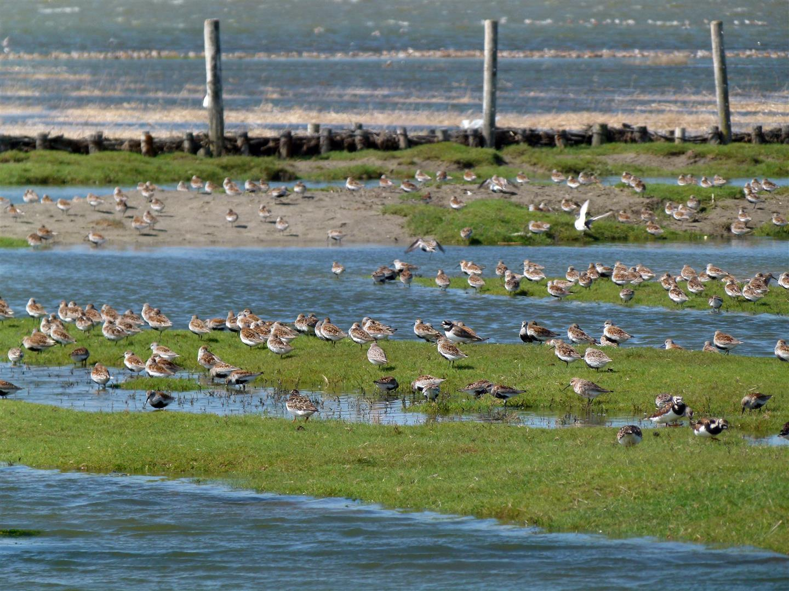
iTAG - Motivation
Notes:
Sample images taken during surveys
Land based survey near büsum, sh

Slide 3
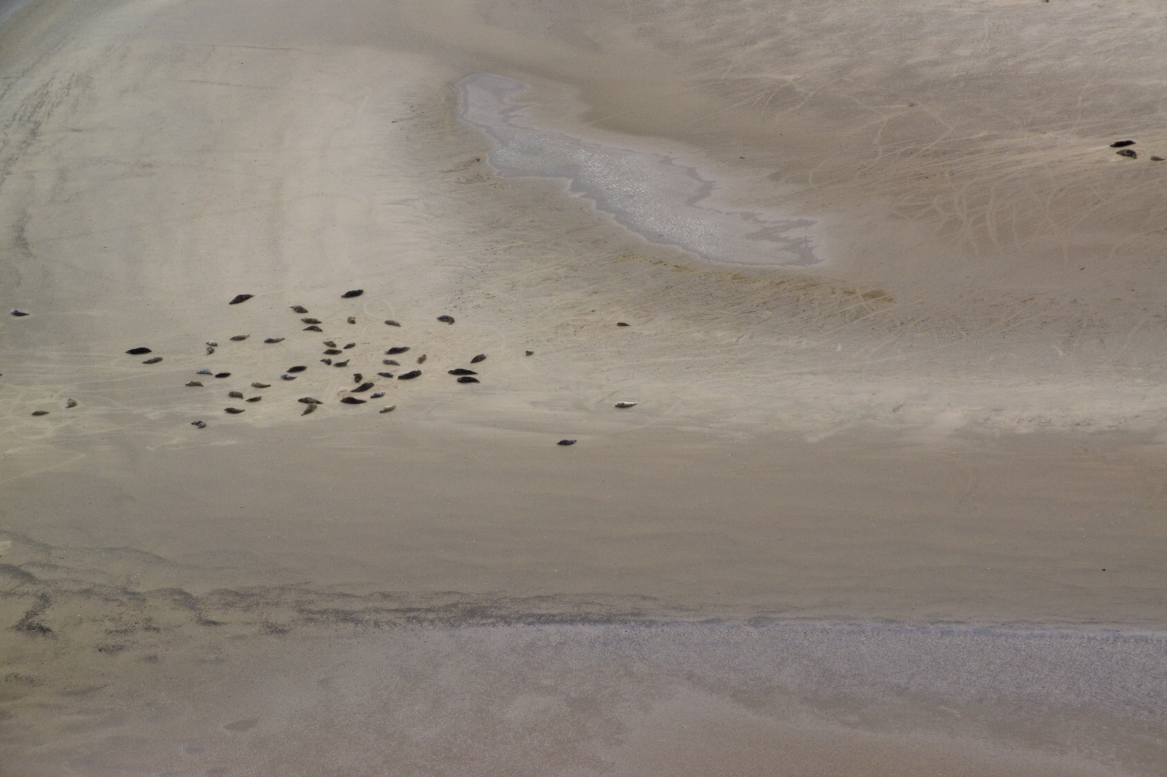
iTAG - Motivation
Notes:
Sample images taken during aerial survey over wadden sea
Grey Seals or harbour seals?
Adult or puppies?

Slide 4
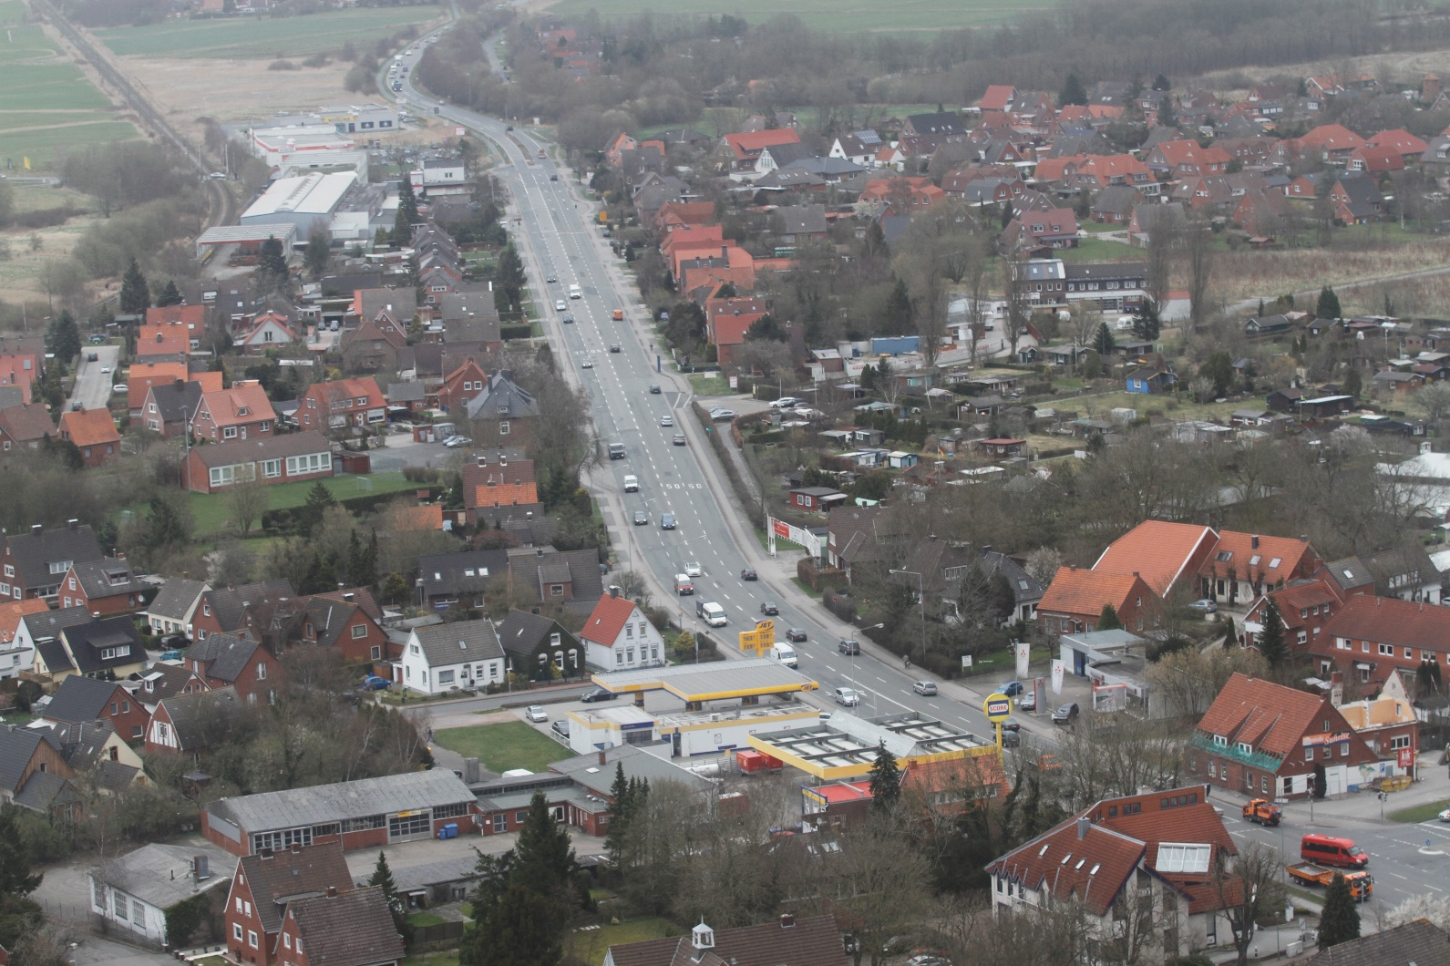
iTAG - Motivation
Notes:
Object counts in general
Automatic detection of different car brands colours etc. not easily achievable

Slide 5
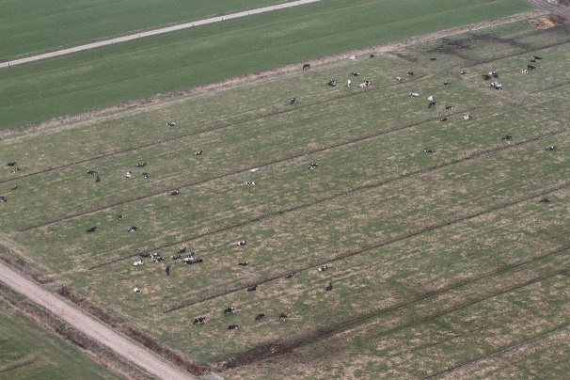
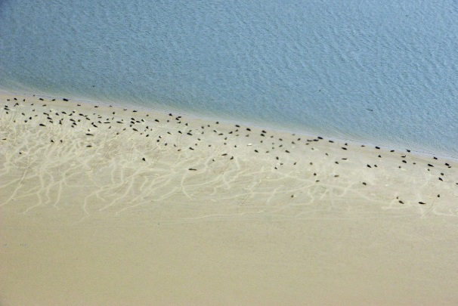
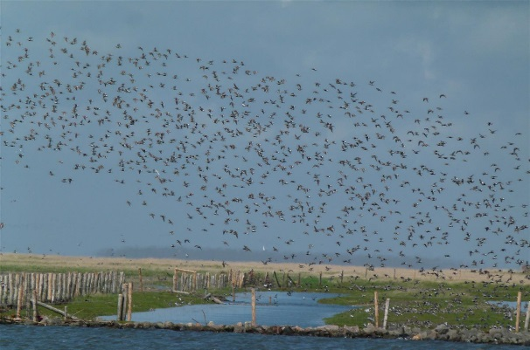
iTAG - Motivation
Aerial surveys producing images of objects often rely on manual census
This is time consuming and error prone
Surprisingly, there is no widely available, open source software to help with that task
Notes:
That applies mostly to surveys where automated detection algorithms do not work

Slide 6
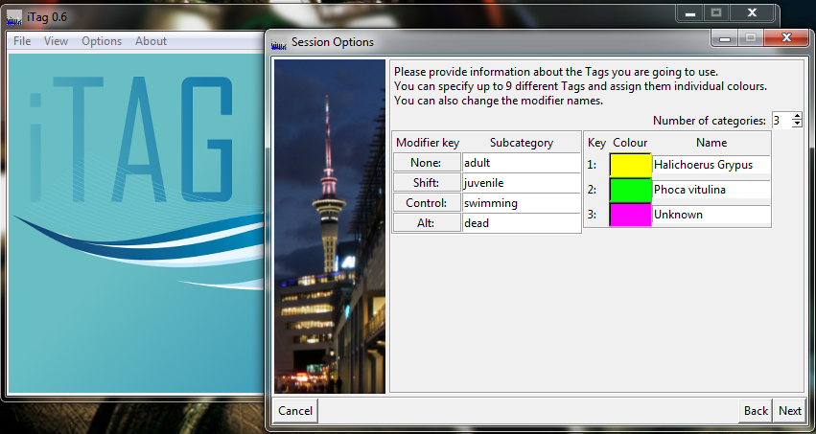
iTAG - Features
iTAG provides an easy to use image viewer with capabilities to tag objects
up to 9 different categories with 3 modifiers per category
Notes:
Specifically designed to combine the workflow of tagging, modifying and aggregating object counts on images
Support for archival and revisiting previous sessions

Slide 7
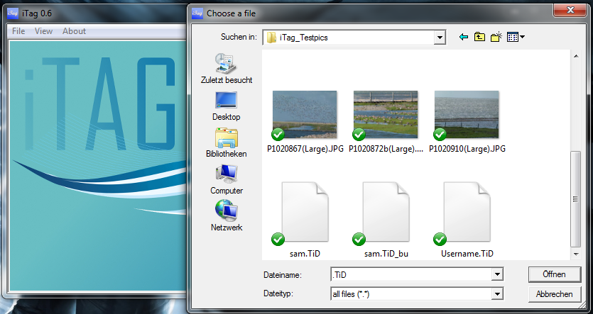
iTAG - Features
create different setups for different scenarios
create separate sessions for different users
save & resume previously saved sessions
Notes:
Allows QA on survey results by allowing for review and archival

Slide 8
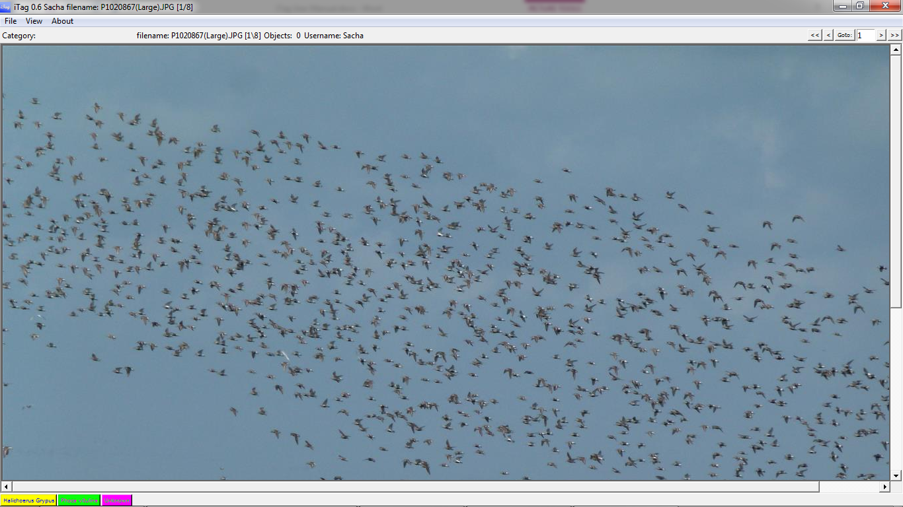
iTAG - Features
Notes:
Image display in iTAG 0.6
Buttons at bottom, accessible by 1-3

Slide 9
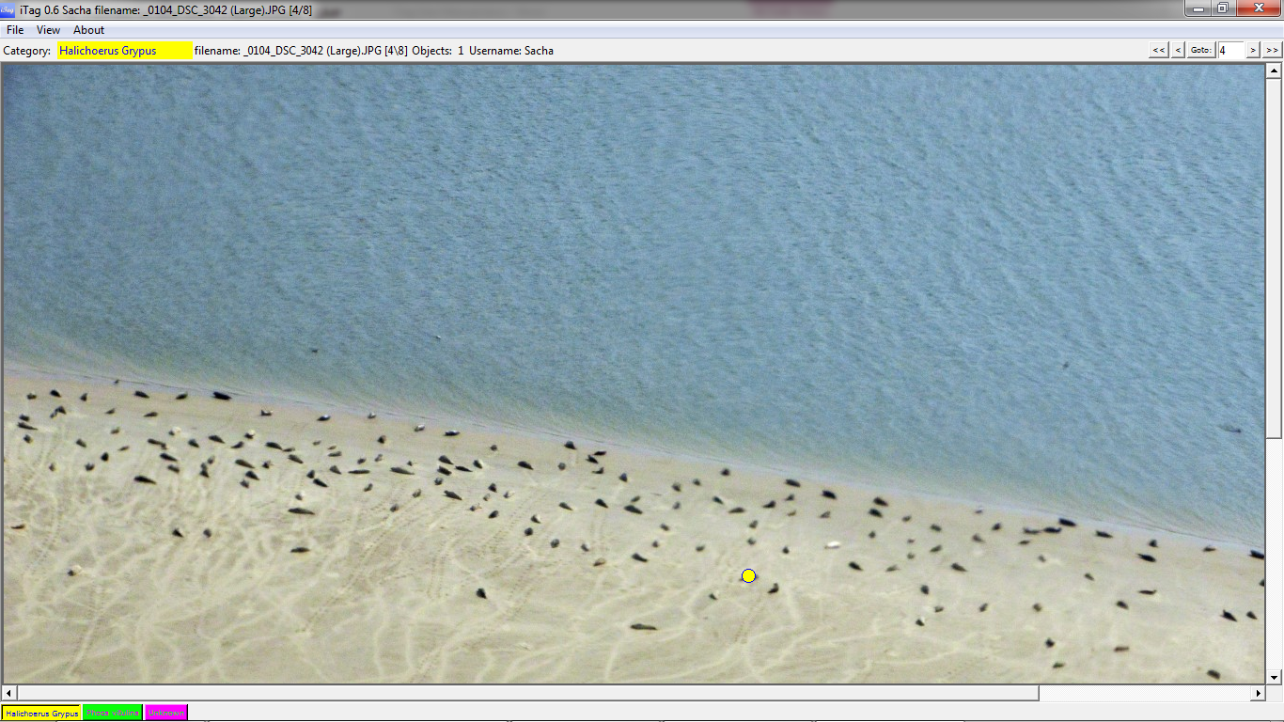
iTAG - Features
Notes:
Tag added

Slide 10
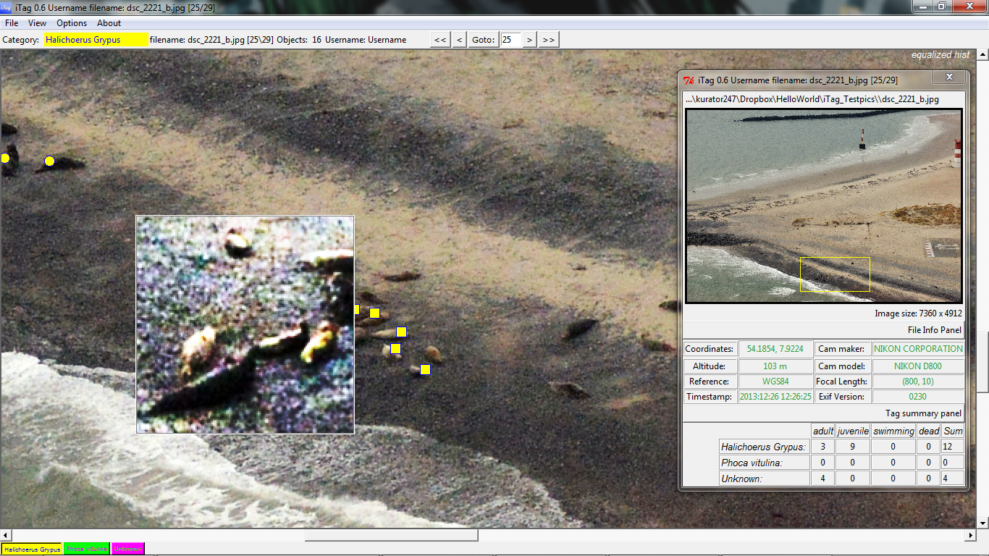
iTAG - Features
Notes:
Magnifier mode with different filter options
Overview panel displaying various info derived from session and exifinfo

Slide 11
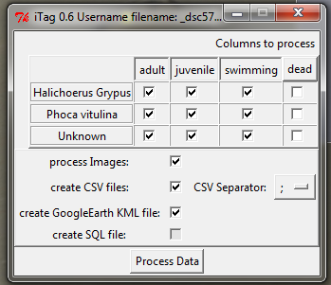
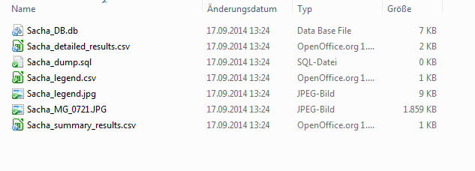
iTAG - Features
Basic output: SQLite database file
Optional output includes:
Tagged images
Spreadsheet files
Google Earth KML file
Notes:
Modifiable levels of output
Based on user and put in seperate folder within image folder

Slide 12
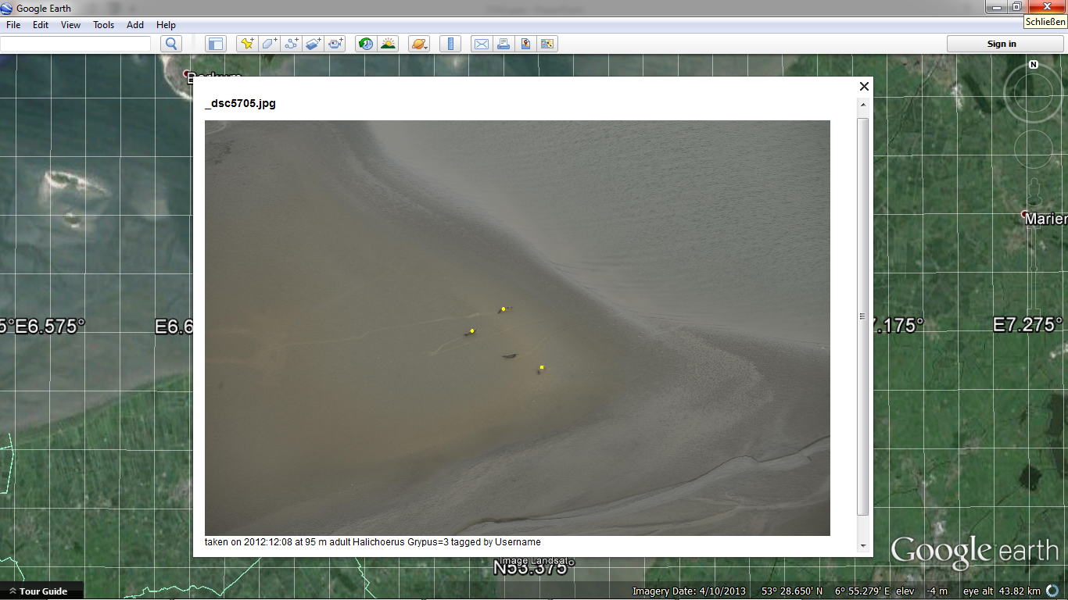
iTAG - Features
Notes:
Magnifier mode with different filter options
Google earth kml output for future reference

Slide 13
iTAG - User base
used by various groups from more than 12 countries
added to the list of recommended software compiled by the ‘Centre of Biodiversity and sustainable Land Use’ at the University of Göttingen (http://www.tropical-studies.uni-goettingen.de/wiki/index.php/Main_Page)
used in various setups, e.g. beach section monitoring of cars and people
Notes:
Was first uploaded on sourceforge on Oct 29th and has since been downloaded 200+ times

Slide 14
iTAG – Upcoming Features
Features to be included in version 0.6.1
toolbox to modify existing tags
per channel image operations (R,G,B,A)
Global image effects
Notes:
Image display is limited by underlying tk interface
Migration to c# is in progress, but plays second fiddle

Slide 15
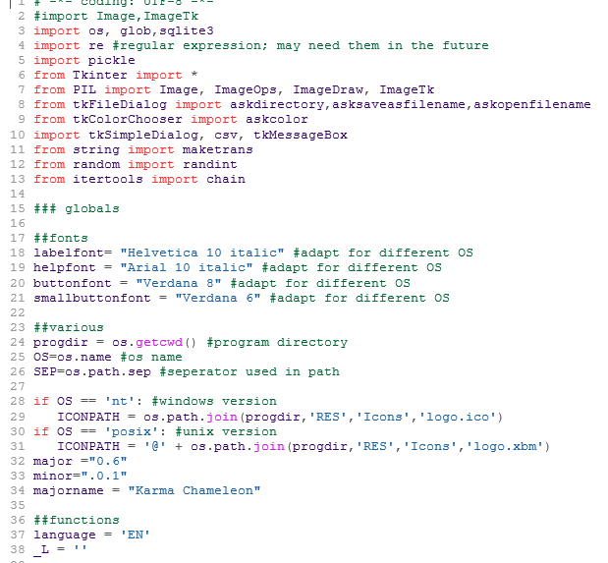
iTAG - Features
Source code available online
Completely written in Python 2.7
Licensed under LGPL (due to PIL library)
Notes:
However, since the whole software is open source, own modifications can be added without much ado

Slide 16
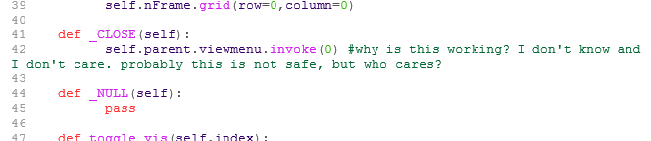
Weblinks
Notes:
Help is always appreciated,

Slide 17
Weblinks
http://sourceforge.net/projects/itagbiology/
Contact:
itag.biology@yahoo.com
sacha.Viquerat@tiho-hannover.de
Notes:
Contact me!!!

Slide 18
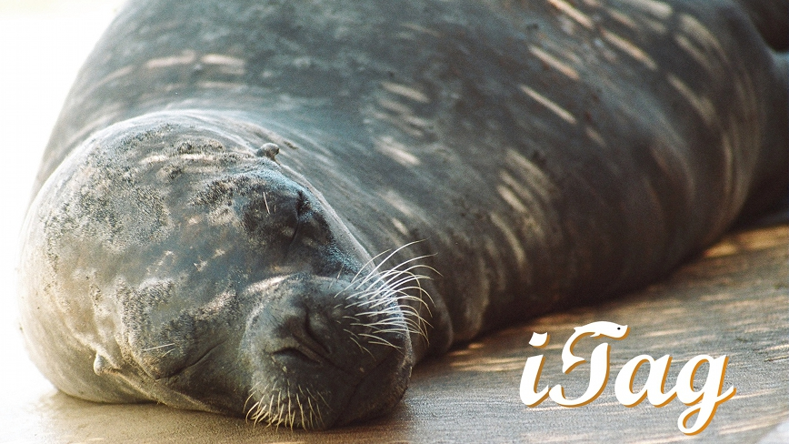
Thank you for your attention

